Slide 1
Town Hall on FEMA Bi-OP
Mayor Henry Balensifer
Planning Director Matthew Ellis
With special guests
Clatsop County Commission Chair Mark Kujala
Clatsop County Community Development Director Gail Henrikson

Slide 2
1
Development
Development means any man-made change to improved or unimproved real estate, including but not limited to buildings or other structures, mining, dredging, filling, grading, paving, excavation or drilling operations or storage of equipment or materials.
44 CFR 59.1
City of Warrenton

Slide 3
2
NFIP
The National Flood Insurance Program (NFIP) is managed by the FEMA and provides flood insurance to property owners, renters, and businesses across the country.
Participation in the NFIP is required for community members to receive federal flood insurance protection, federal loans on properties in the floodplain, and response and recovery
funding for federally-declared disasters.
City of Warrenton

Slide 4
3
Timeline
City of Warrenton

Slide 5
4
PICM Options
(Pre-Implementation Compliance Measures)
1
Prohibit all new development in the floodplain.
City of Warrenton
2
Incorporate the Endangered Species Act into local floodplain ordinances.
3
Require floodplain development permit applicants to develop a Floodplain Habitat Assessment documenting that their proposed development in the Special Flood Hazard Area will achieve “no net loss.”

Slide 6
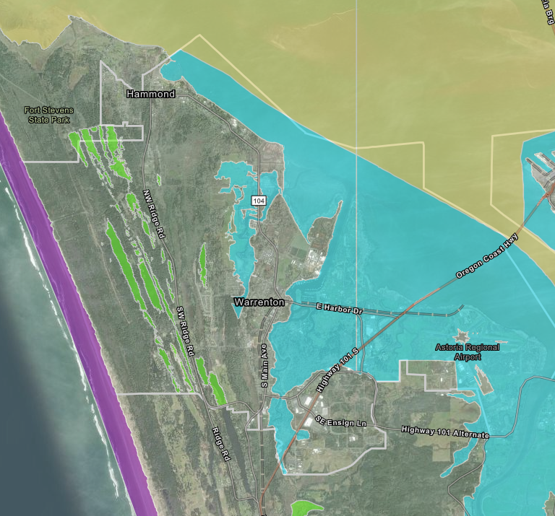
5
Areas of Special Flood Hazard in Warrenton
City of Warrenton

Slide 7
6
Riparian Buffer Zones (RBZs)
Only applies in SFHA (blue)
Purple: Columbia River
Orange: Skipanon River
Red: Alder Creek
City of Warrenton

Slide 8
7
Case Study 1
New 2,000 square foot home
Next to Alder Creek or Skipanon River
Assume 2 feet of fill to build 1 foot above Base Flood Elevation
Total Impervious Surface: 2,400 square feet (400 sf driveway)
Mitigation required for fill: 4,000 cubic feet
Mitigation required for Impervious Surface: 2,400 square feet
3, 5, or 6 trees (based on size) for every tree removed
City of Warrenton

Slide 9
8
Case Study 2
Remodel of 1,500 square foot home (Substantial Improvement)
Anywhere in the Area of Special Flood Hazard (floodplain)
Assume 2 feet of fill to build 1 foot above Base Flood Elevation
Total New Impervious Surface: 0 square feet
Mitigation required for fill: 2,250 cubic feet (1.5 x 1,500)
Mitigation required for Impervious Surface: 0 square feet
2, 4, or 5 trees (based on size) for every tree removed
City of Warrenton

Slide 10
9
Case Study 3
Heating unit replacement (non-Substantial Improvement)
Anywhere in the Area of Special Flood Hazard (floodplain)
Exempt from No Net Loss Standards
Still needs a Floodplain Development Permit
City of Warrenton

Slide 11
Clatsop County PICM Status
10
TWO PATHS:
1. PICM PATHWAY
Board of Commissioner work sessions:
August 14
August 28
November 6
Board to consider temporary moratorium on floodplain permits
If approved, moratorium effective November 13, 2024-February 28, 2025
Board to consider formal vote on PICM at November 13 meeting
2. OREGONIANS FOR FLOODPLAIN PROTECTION
Coalition started by Tillamook County
County pledge of $25,000
Possible litigation
Delay or reverse December 1 deadline
October 28, 2024

Slide 12
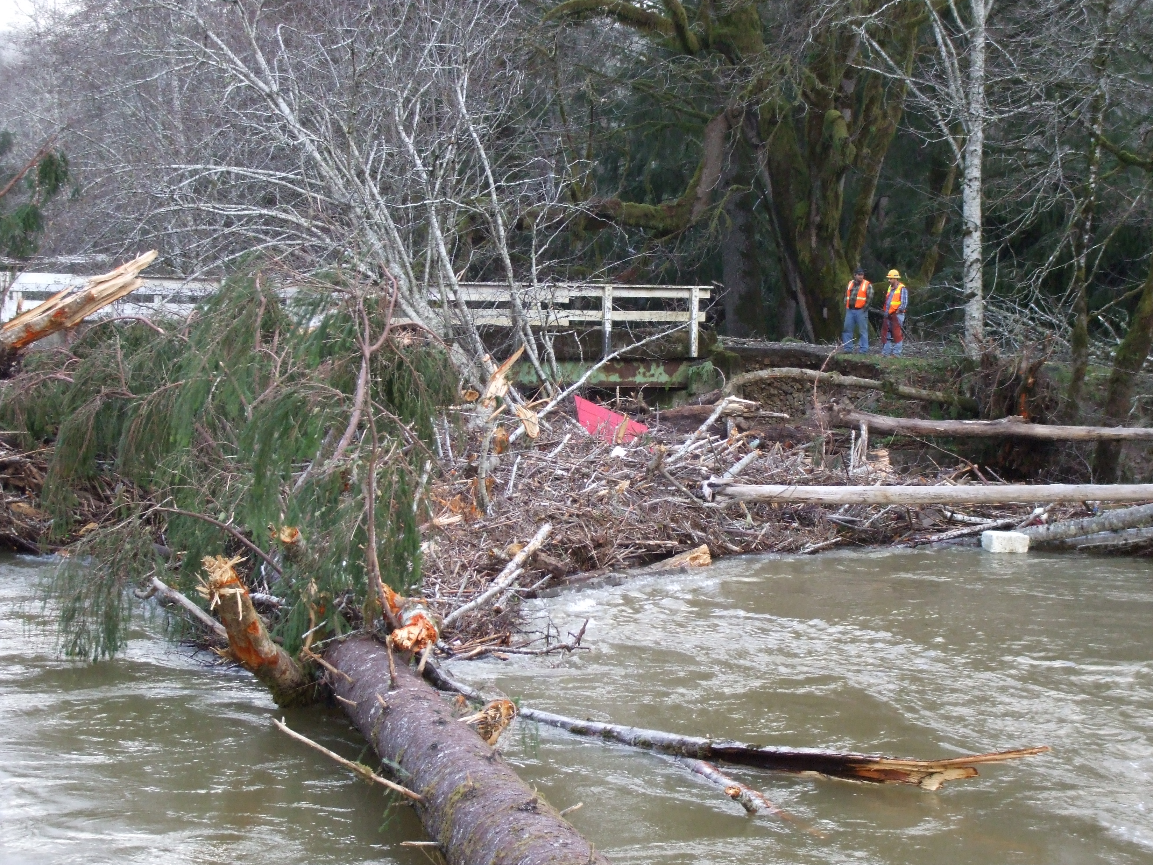
Development Scenarios – Unincorporated Clatsop County
11
October 28, 2024

Slide 13
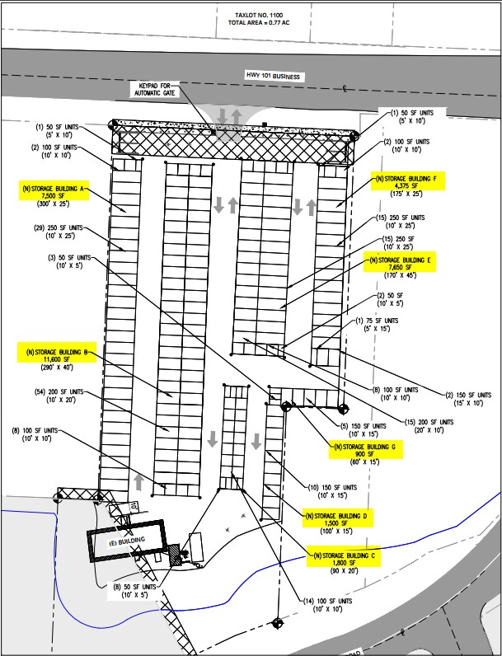
12
Mini-Warehouse Facility
Mini-storage facility in Miles Crossing
191 units in 7 buildings: 33,875 SF building
Existing impervious: ~66,000 SF
Proposed impervious: ~66,360
Trees Removed: 0
Site Elevation: 9’
BFE: 12’
Special Flood Hazard Area: AE – 100 Year Flood
October 28, 2024
Notes:
Astoria School Tax: $0.25/SF (Residential) and $0.53/SF (Commercial)

Slide 14
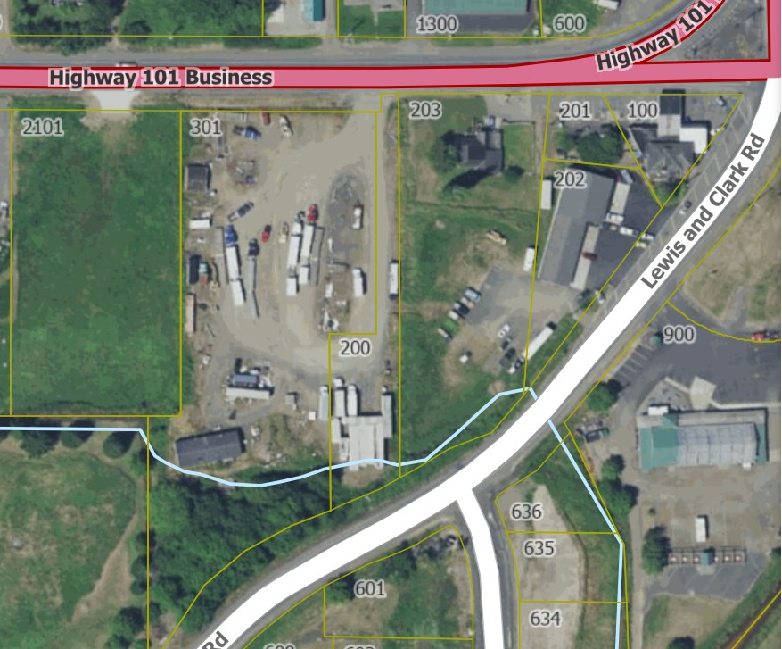
LOCATING MITIGATION
Compensatory storage must be:
On-site; or
Offsite, but within the same waterbody reach
Offsite mitigation that is in a different reach, but within the same watershed, must be provided at double the rate
13
 | Existing Conditions | Proposed Conditions | Difference | Existing Elevation | Base Flood Elevation | Difference | Total Loss Requiring Mitigation | Mitigation Ratio | Required Mitigation
UNDEVELOPED SPACE | 0 SF Buildings | 33,875 SF Buildings | +33,875 SF | 9’ | 12’ | 3’ | 33,875 SF x 3’ = 101,625 CF | 1.5:1 | 152,437.5 CF compensatory storage
 | O SF Sign | 4 SF Sign Post | 4 SF | 9’ | 12’ | 3’ | 4 SF x 3’ = 12 CF | 1.5:1 | 18 CF compensatory storage
 | O SF fence posts | 12 SF fence posts (108 3”x3” posts spaced 8’ apart) | 12 SF | 9’ | 12’ | 3’ | 12 SF x 3’ = 36 CF | 1.5:1 | 54 CF compensatory storage
TOTAL |  |  |  |  |  |  |  |  | 152,509.5 CF
PERVIOUS AREA | 66,000 SF | 66,360 SF | 360 SF | N/A | N/A | N/A | 360 SF | 1:1 | 360 SF new pervious area
TREES | 0 | 0 | 0 | N/A | N/A | N/A | 0 | 0 | 0
ADDITIONAL MITIGATION REQUIREMENTS
Applicant must demonstrate legal right to implement the mitigation property (i.e., owns property or has easement)
Demonstrate financial assurance are in place for long-term maintenance and monitoring
Develop a management plan identified:
Site manager
Activities allowed on site
Posting of signs
October 28, 2024
Notes:
Astoria School Tax: $0.25/SF (Residential) and $0.53/SF (Commercial)

Slide 15
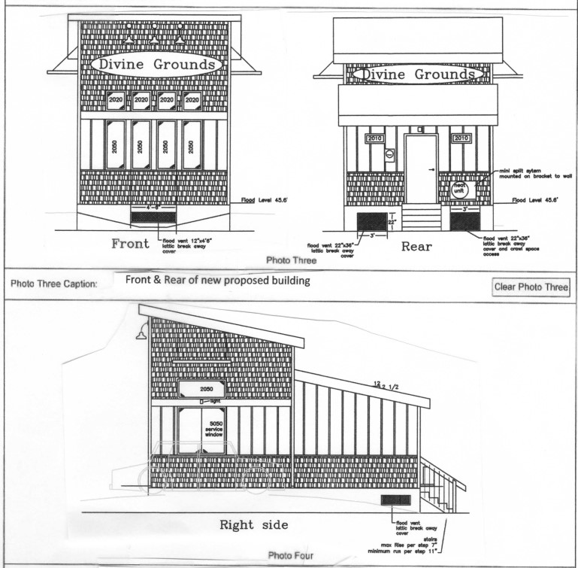
14
Coffee Kiosk
Coffee kiosk (Highway 101/26 junction)
Existing building: 157 SF
Proposed building: 420 SF
New impervious area: 0 SF
Trees Removed: 0
Site Elevation: 43.2’
BFE: 44.6’
Special Flood Hazard Area: AE-100 Year Flood/Floodway
October 28, 2024
Notes:
Astoria School Tax: $0.25/SF (Residential) and $0.53/SF (Commercial)

Slide 16
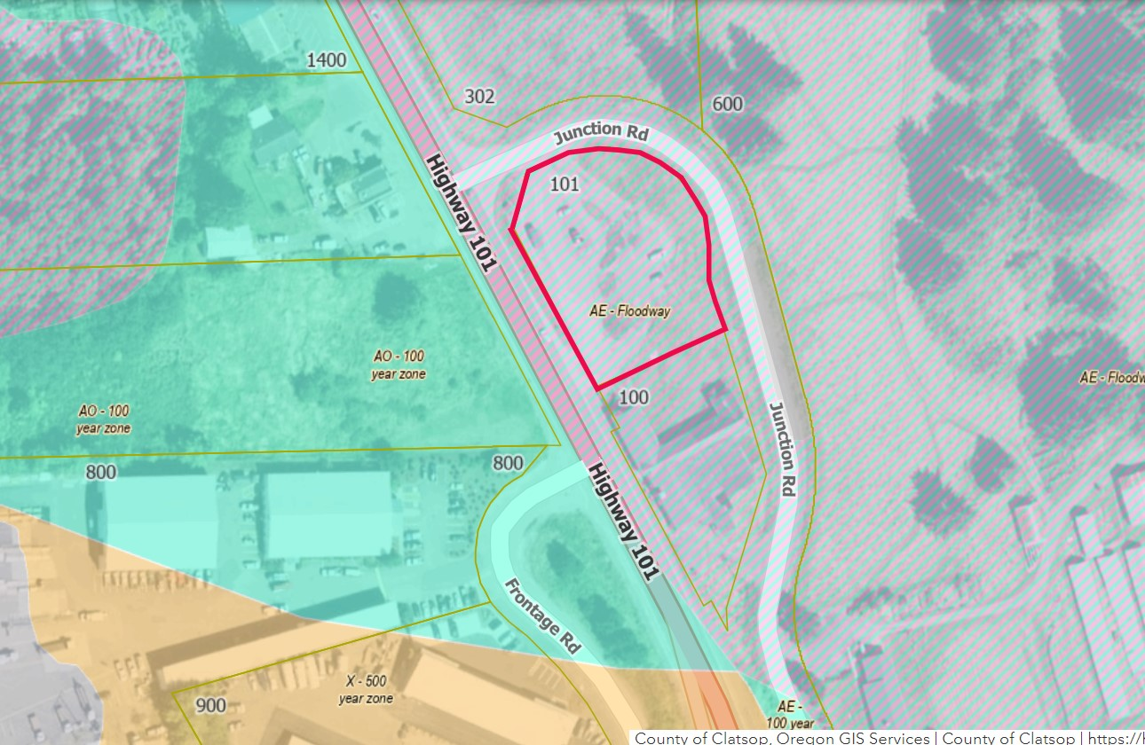
15
LOCATING MITIGATION
Compensatory storage must be:
On-site; or
Offsite, but within the same waterbody reach
Offsite mitigation that is in a different reach, but within the same watershed, must be provided at double the rate
 | Existing Conditions | Proposed Conditions | Difference | Existing Elevation | Base Flood Elevation | Difference | Total Loss Requiring Mitigation | Mitigation Ratio | Required Mitigation
UNDEVELOPED SPACE | 157 SF Buildings | 420 SF Buildings | +263 SF | 43.2’ | 44.6’ | 1.4’ | 263 SF x 1.4’ = 368.2 CF | 2:1 | 736.4 CF compensatory storage
TOTAL |  |  |  |  |  |  |  |  | 736.4 CF
NEW IMPERVIOUS AREA | N/A | N/A | N/A | N/A | N/A | N/A | N/A | N/A | N/A
TREES | 0 | 0 | 0 | N/A | N/A | N/A | 0 | 0 | 0
ADDITIONAL MITIGATION REQUIREMENTS
Applicant must demonstrate legal right to implement the mitigation property (i.e., owns property or has easement)
Demonstrate financial assurance are in place for long-term maintenance and monitoring
Develop a management plan identified:
Site manager
Activities allowed on site
Posting of signs
October 28, 2024
Notes:
Astoria School Tax: $0.25/SF (Residential) and $0.53/SF (Commercial)

Slide 17
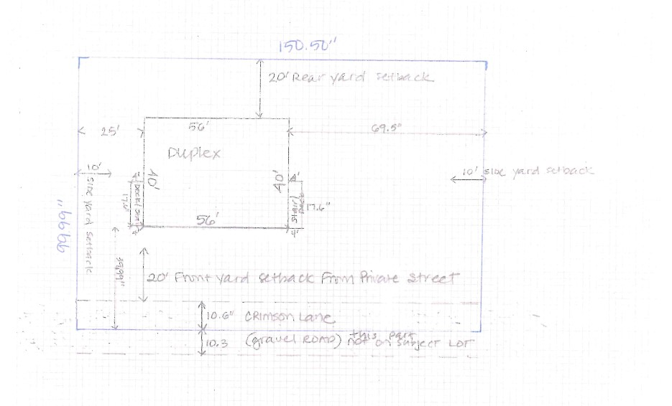
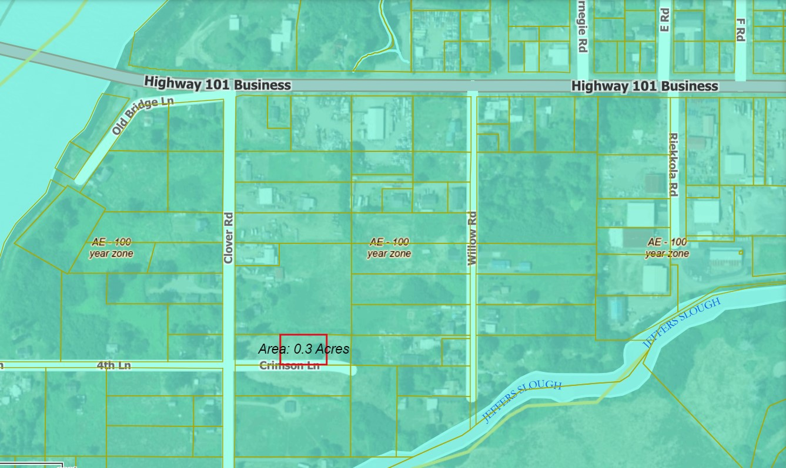
16
DUPLEX
New duplex on undeveloped land in Jeffers Garden
Lot size: 15,050 SF
Proposed footprint:
2,240 SF duplex footprint
70.4 SF back stairs
70.4 SF front porch
New impervious area:
1,595.3 SF – Crimson Lane extension
684 SF – parking area
Trees Removed: 0
Site Elevation: 6.2’
BFE: 12.0’
Special Flood Hazard Area: AE-100 Year Flood
October 28, 2024
Notes:
Astoria School Tax: $0.25/SF (Residential) and $0.53/SF (Commercial)

Slide 18
LOCATING MITIGATION
Compensatory storage must be:
On-site; or
Offsite, but within the same waterbody reach
Offsite mitigation that is in a different reach, but within the same watershed, must be doubled
17
 | Existing Conditions | Proposed Conditions | Difference | Existing Elevation | Base Flood Elevation | Difference | Total Loss Requiring Mitigation | Mitigation Ratio | Required Mitigation
UNDEVELOPED SPACE | 0 SF Buildings | 2,240 SF Buildings | +2,240 SF | 6.2’ | 12.0’ | 5.8’ | 2,240 SF x 5.8’ = 12,992 CF | 1.5:1 | 19,488 CF compensatory storage
 | 0 SF stairs | 70.4 SF | +70.4 SF | 6.2 | 12.0 | 5.8’ | 70.4 SF x 5.8’ = 408.32 CF | 1.5:1 | 612.48 CF compensatory storage
 | 0 SF porch | 70.4 SF | +70.4 SF | 6.2 | 12.0 | 5.8’ | 70.4 SF x 5.8’ = 408.32 CF | 1.5:1 | 612.48 CF compensatory storage
TOTAL |  |  |  |  |  |  |  |  | 20,712.96 CF
NEW IMPERVIOUS AREA | 0 SF | 1,595.3 SF Crimson Lane extension | +1,595.3 SF | N/A | N/A | N/A | 1,595.3 SF | 1:1 | 1,595.3 SF
 | 0 SF | 684 SF parking | +684 SF | N/A | N/A | N/A | 684 SF | 1:1 | 684 SF
TOTAL |  |  |  |  |  |  |  |  | 2,279.3 SF
TREES | 0 | 0 | 0 | N/A | N/A | N/A | 0 | 0 | 0
ADDITIONAL MITIGATION REQUIREMENTS
Applicant must demonstrate legal right to implement the mitigation property (i.e., owns property or has easement)
Demonstrate financial assurance are in place for long-term maintenance and monitoring
Develop a management plan identified:
Site manager
Activities allowed on site
Posting of signs
October 28, 2024
Notes:
Astoria School Tax: $0.25/SF (Residential) and $0.53/SF (Commercial)

Slide 19
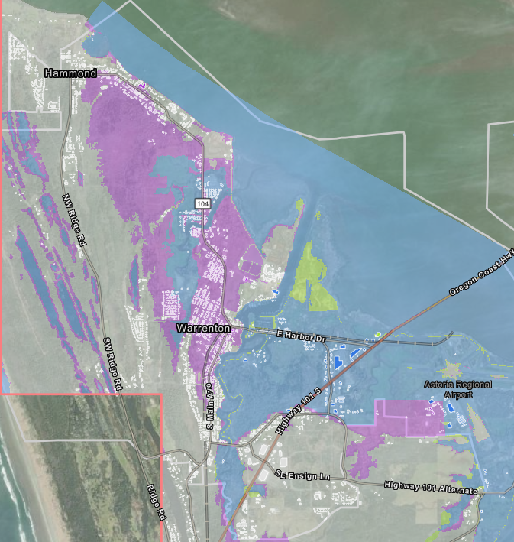
18
RISK Rating 2.0
Several year review process
Currently 455 structures in the floodplain (blue)
Proposed 1,480 structures in the floodplain (purple)
Map viewer: https://tinyurl.com/DraftMapsClatsop
City of Warrenton

Slide 20
19
Government Actions
1
Recertification of levees throughout Warrenton.
City of Warrenton
2
Weighing options for Pre-Implementation Compliance Measures.
3
Participating in Oregonians for Floodplain Protection, including potentially participating in litigation.

Slide 21
Questions?
City of Warrenton

