Slide 1
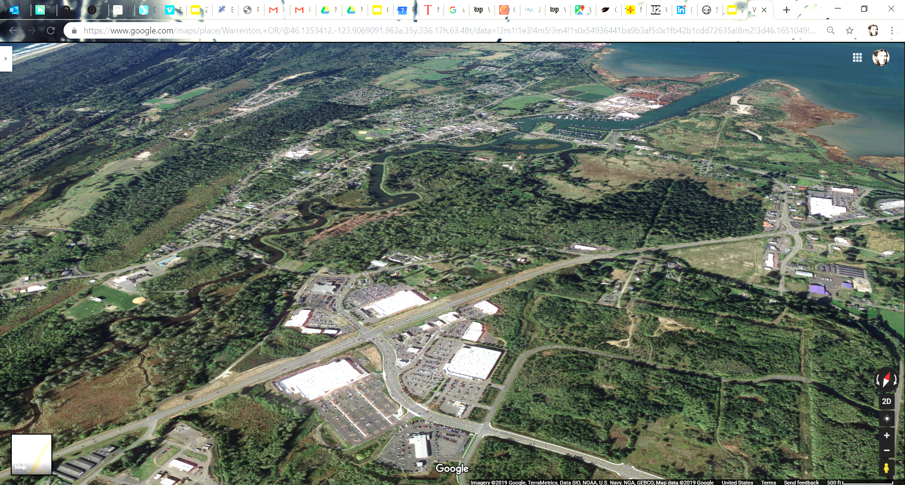
HOUSING CODE UPDATE
&
SPUR 104 MASTER PLAN
WARRENTON, OR
City Commission Work Session
10 December 2019

Slide 2
Separate But Equal….
Each proposal is a standalone policy and code proposal.
Each reinforces the other but “Spur 104” is for a specific geographic area while the “housing code” will apply citywide.
One staff report/public notice for combined findings and hearing procedure for both proposals to economize staff time.
Hold one hearing for both proposals; deliberate in January 2020.
Each need to be adopted by motion and ordinance independently.
Staff will draft ordinance per direction of City Commission.

Slide 3
Housing Policy + Code Update
Housing Needs Assessment completed in June 2019
Code revisions developed in Summer 2019
PC Work Sessions & Hearing in August/September 2019
Comprehensive Plan policy update
Development Code Update (see matrix)
Slightly increases allowable density by lowering minimum lot sizes and requiring minimum standards to develop efficiently
Diversifies allowable housing types; reduce “red tape” for new ADUs
Encourages mixed use in commercial zones
Creates courtyard cottage housing code
PC Recommendation: Removed ADU ready and exterior materials proposal

Slide 4
Questions? Concerns? Revisions?

Slide 5
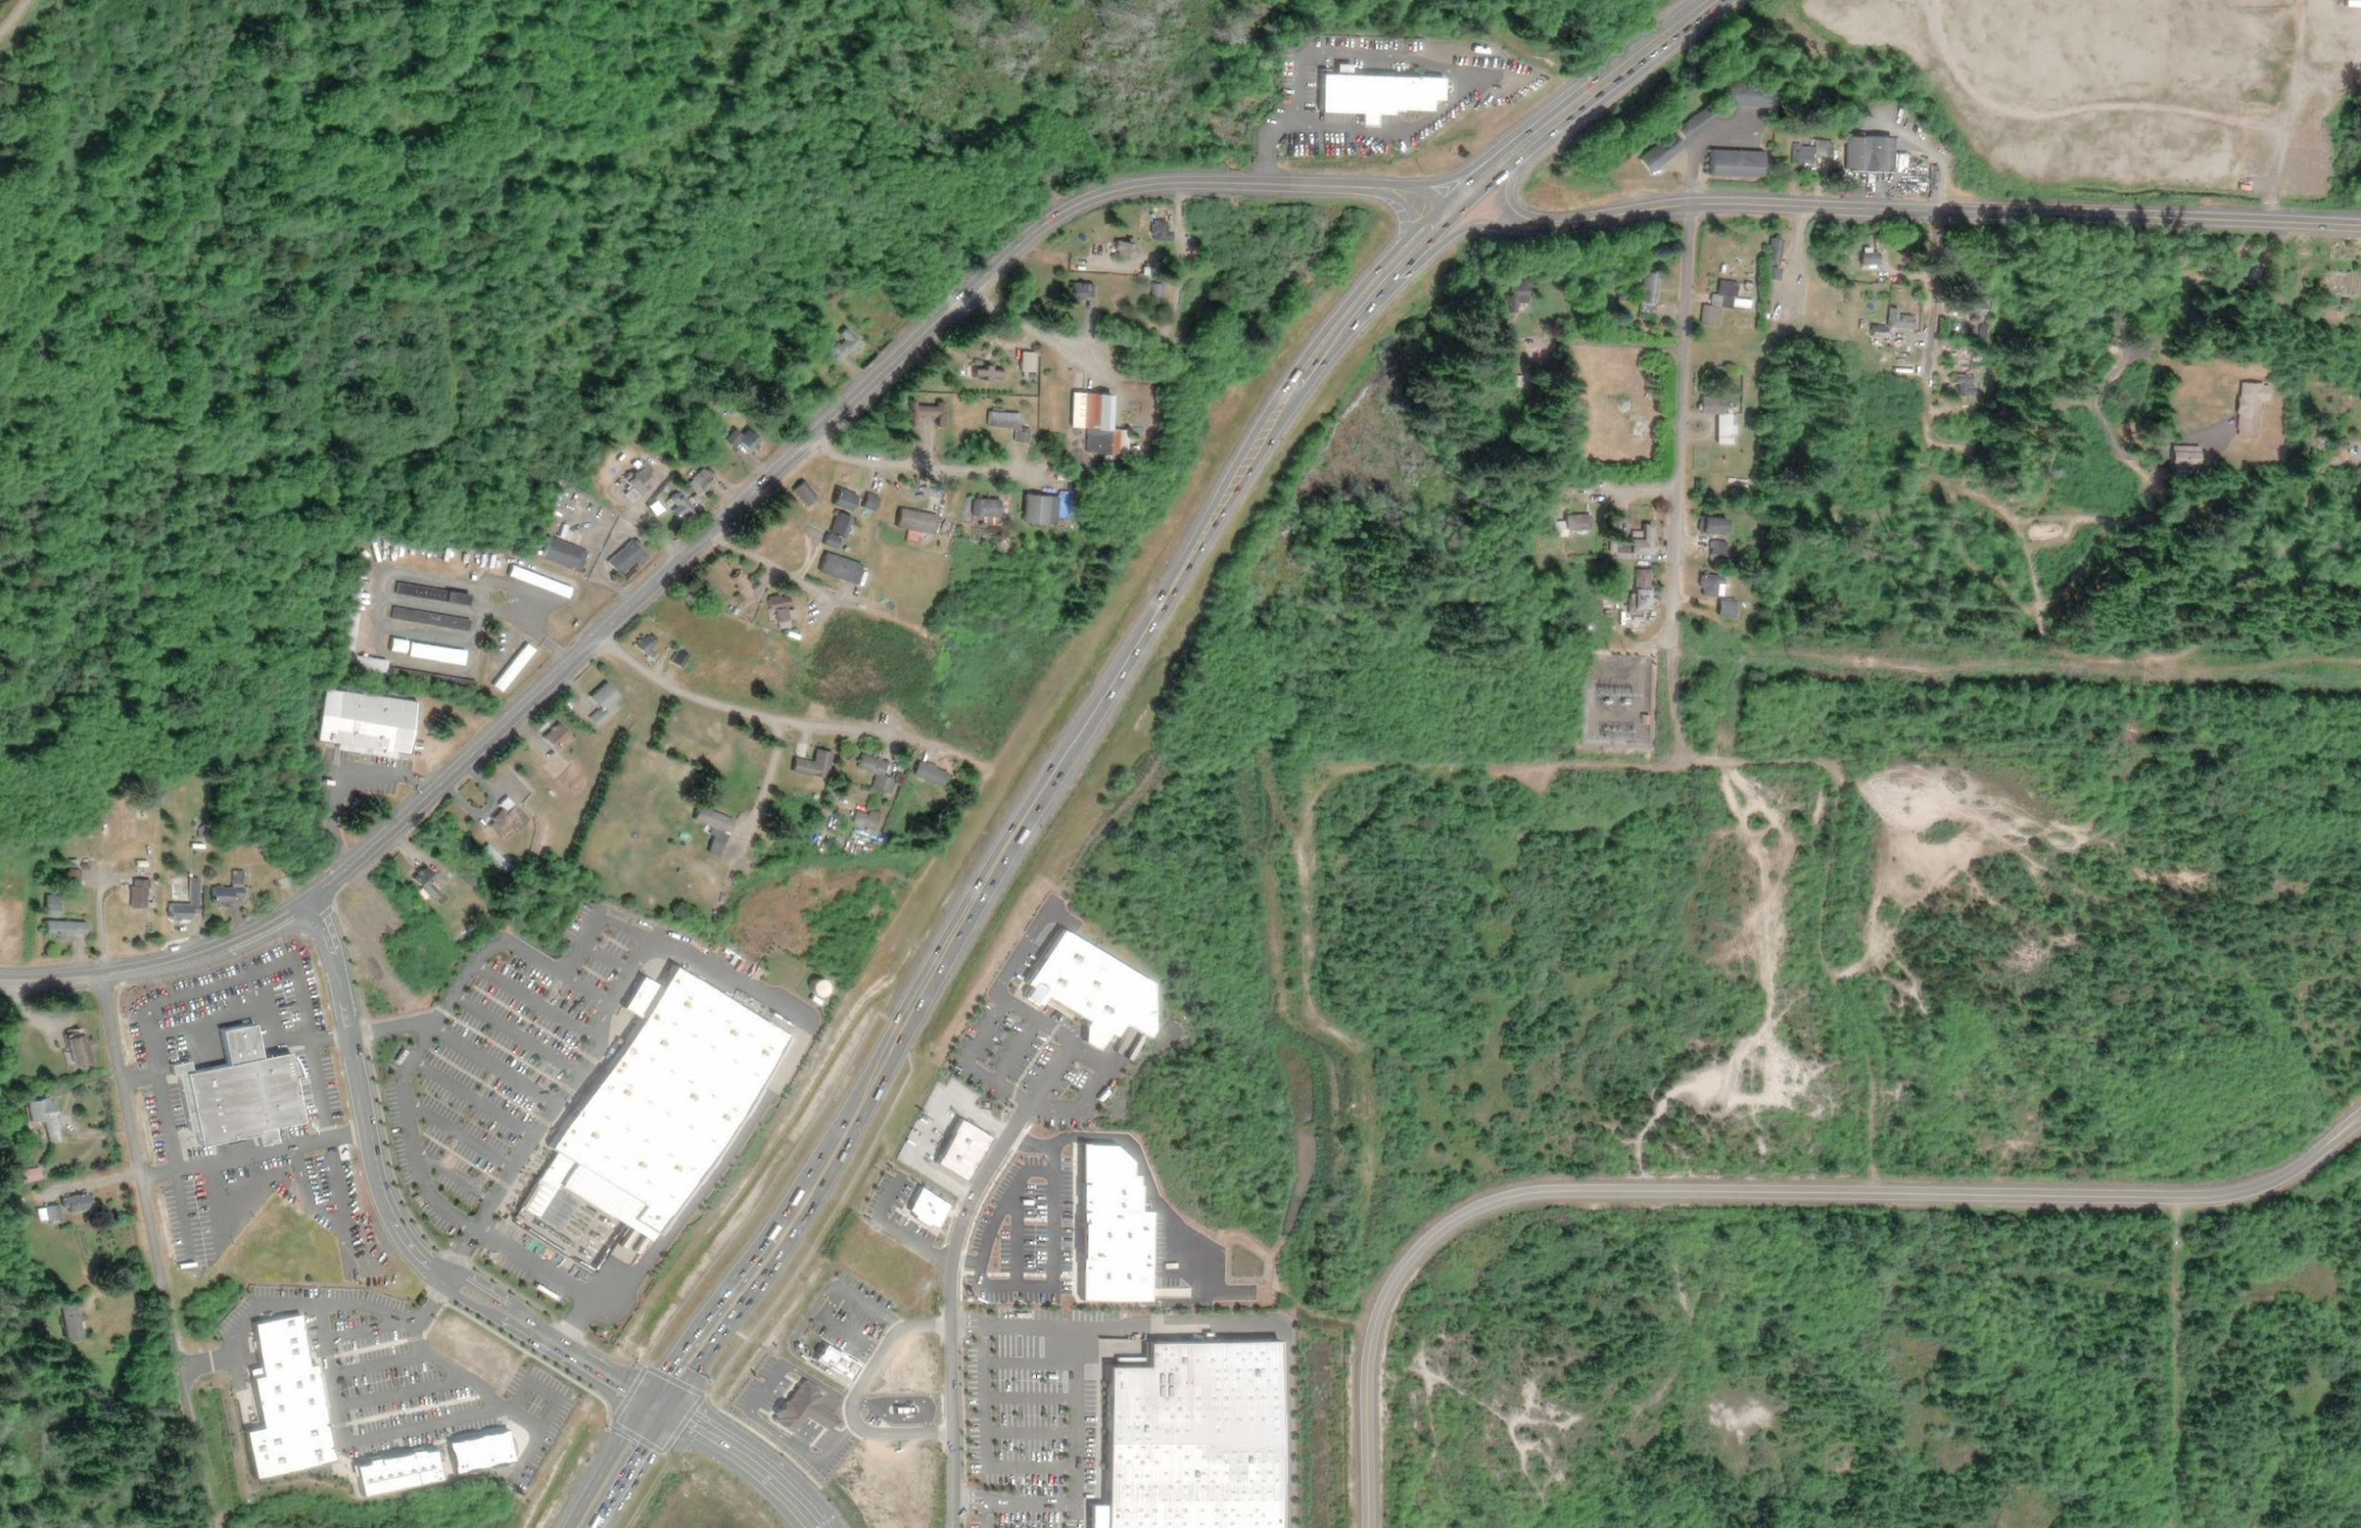
SPUR 104 | CMU SITE FRAMEWORK PLAN :: GOALS
Provide a common framework that balances both certainty and flexibility for stakeholders
Utilize existing right of way (street) pattern
Foster a sense of community
Bolster the neighborhood with a park or common open space for all residents
Create a walkable district
Connect to surrounding community assets, including Downtown
Address traffic issues in conjunction with any new development

Slide 6
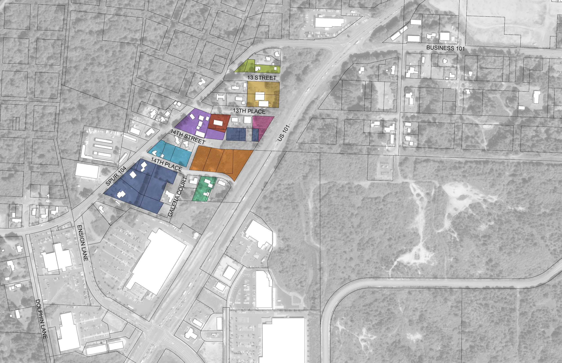
SPUR 104 |CMU SITE FRAMEWORK PLAN :: OWNERSHIP PATTERN
~15.2 total acres proposed for C-MU zoning
Seven (7) owners own two or more taxlots. (Two more own a major parcel plus one or two ‘slivers.’)
Largest landowner owns ~3.5 ac.
Fifteen (15) owners own a single taxlot

Slide 7
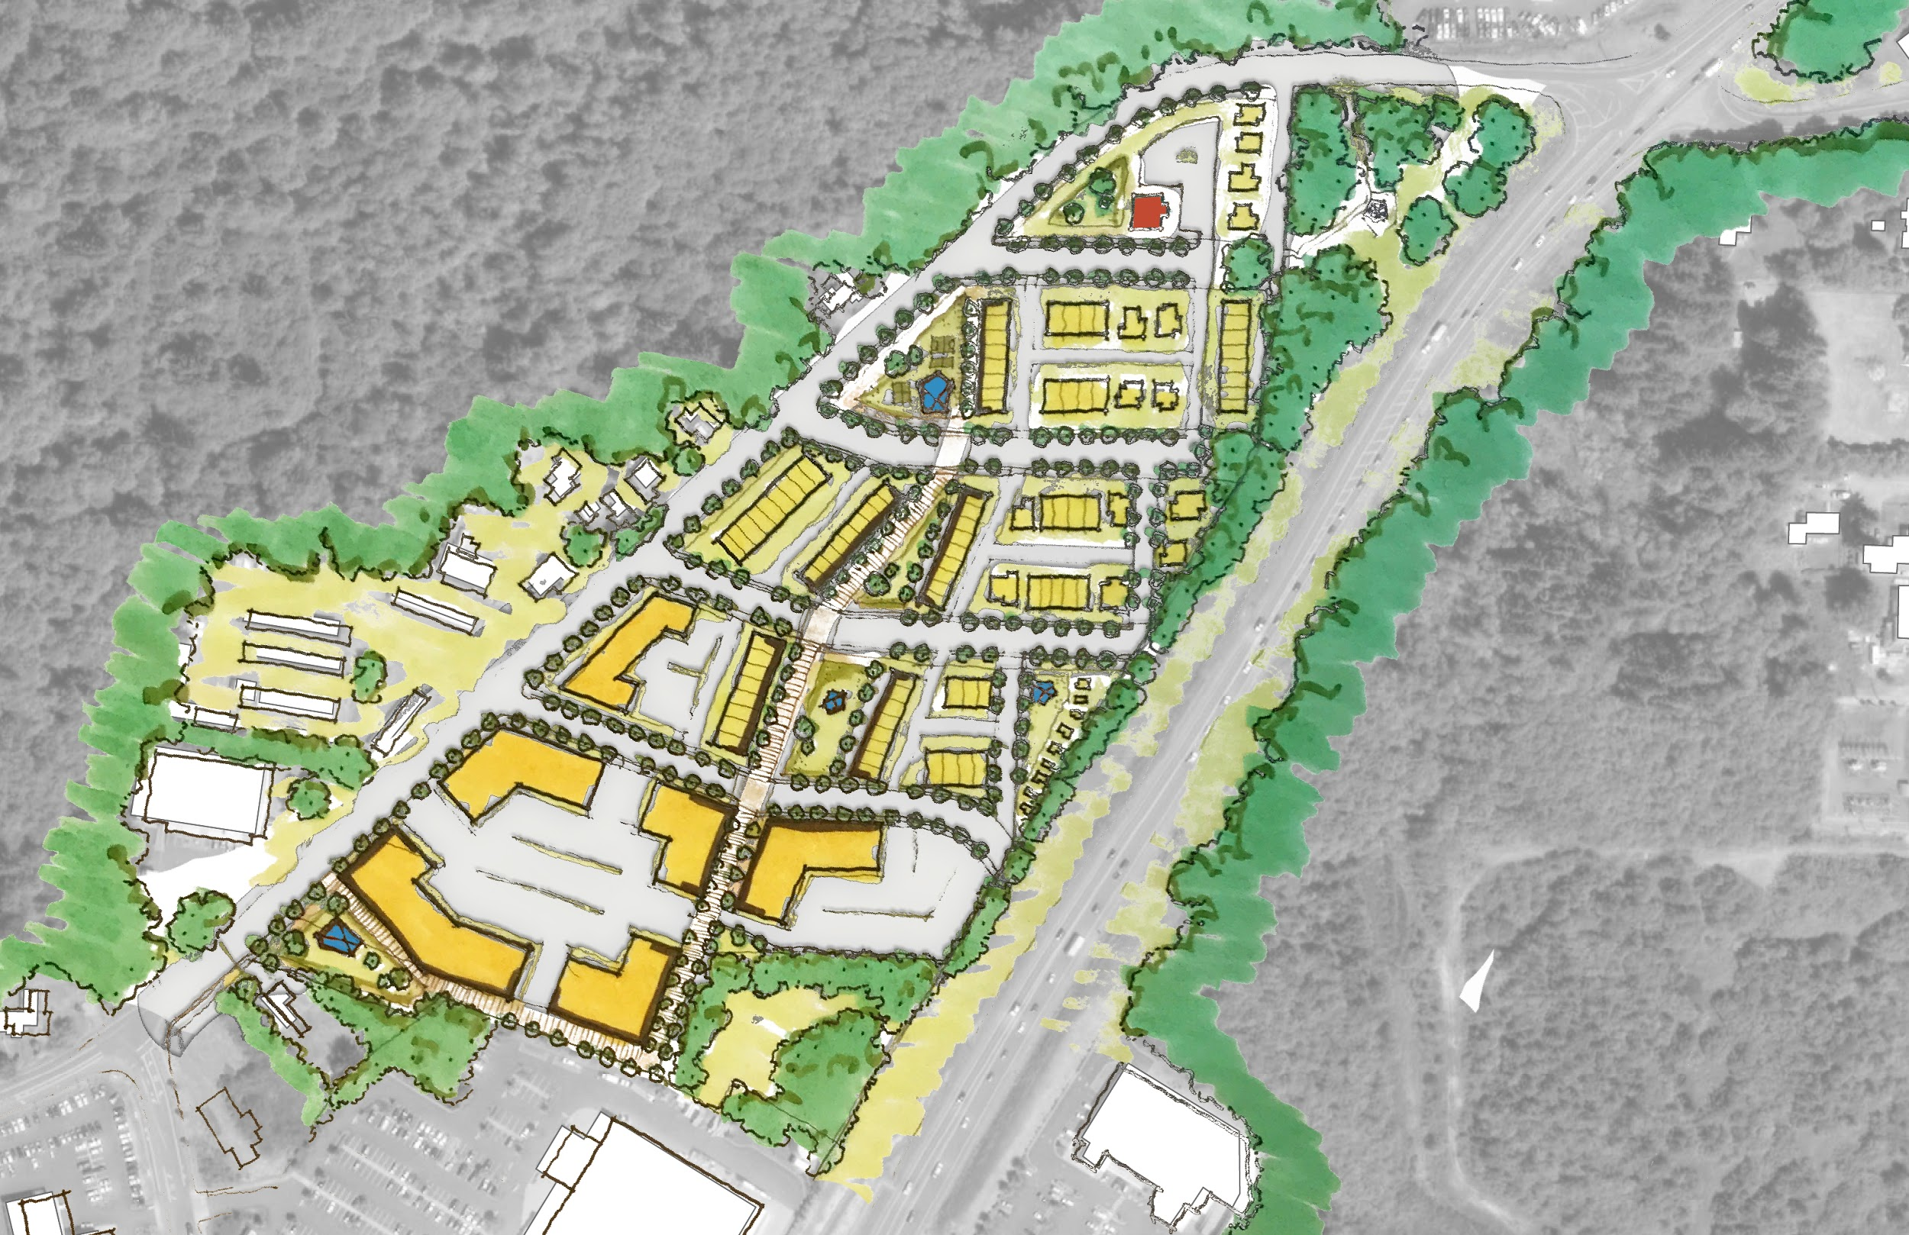
SPUR 104 |CMU SITE FRAMEWORK PLAN :: RESIDENTIAL CONCEPT
~346 Dwelling Units
240 Apartments
83 Townhouses
14 Single-Family
9 Tiny Homes
Community Garden
Existing Wetland Open Space
Neighborhood Park
Perimeter Trail
Townhouses
Apartments
Single-Family
Tiny Homes
Improve Intersection
Pedestrian Promenade
Existing Open Space
Potential Future Connections
Goodwill
Home Depot

Slide 8
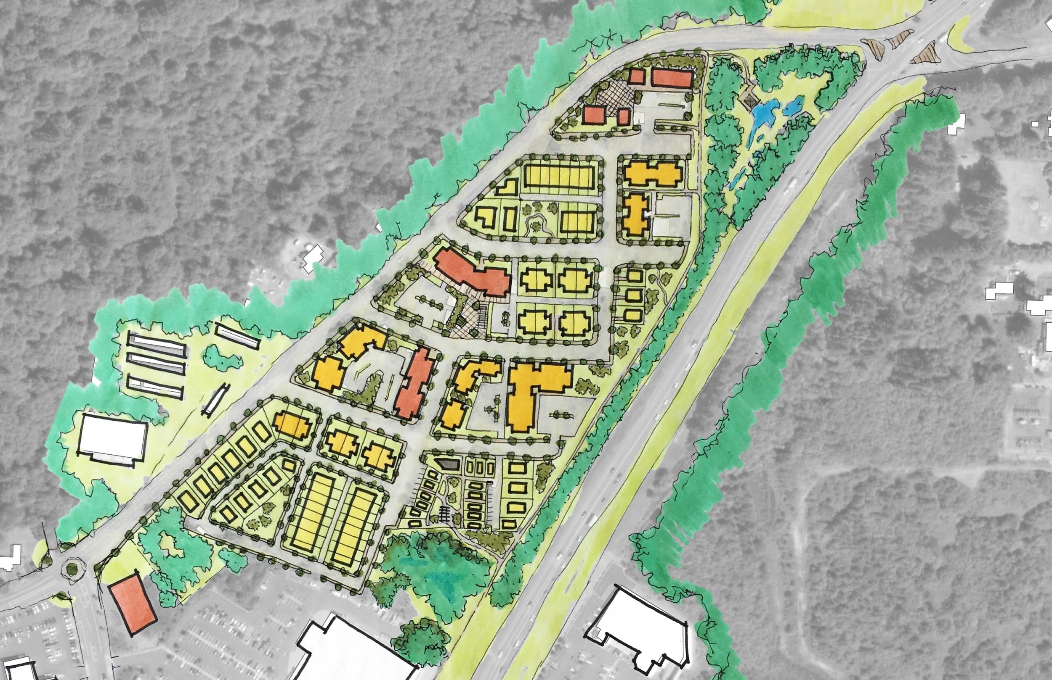
SPUR 104 | CMU SITE FRAMEWORK PLAN :: MIXED-USE CONCEPT
~318 Dwelling Units
14 Cottage Cluster
21 Single Family
15 Duplex/Triplex
28 Townhomes
240 Apartments
~32,800 SF Retail
Housing Above Office
Existing Wetland Open Space
Neighborhood Park
Perimeter Trail
Plaza
Housing Above Retail
Single-Family
Duplexes
Improve Intersection
Cottage Cluster
Existing Open Space
Potential Future Connections
Goodwill
Home Depot

Slide 9
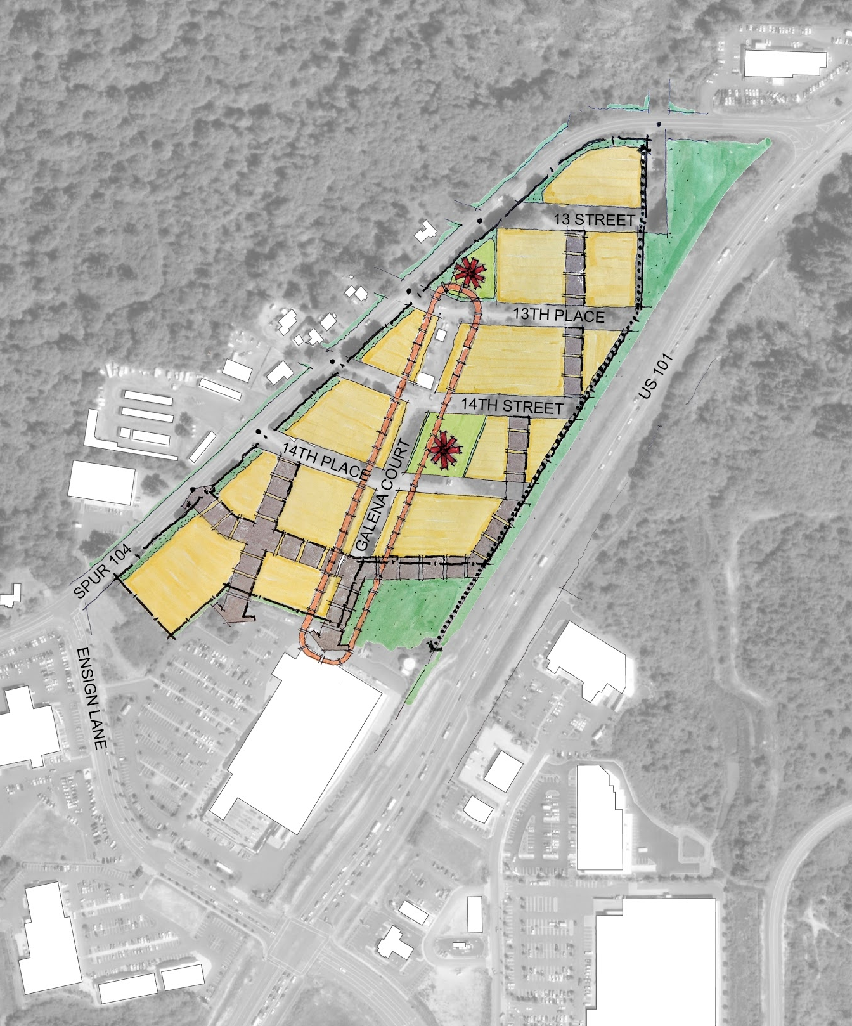
SPUR 104 | CMU SITE FRAMEWORK PLAN :: RECOMMENDATIONS
Provide clear development framework for all property owners
Provide design guidance for various development typologies
Utilize existing right-of-way (street) pattern
Provide street standards that include sidewalks and street trees
Improve the safety of Spur 104 with a continuous sidewalk, reduced speed, landscaping, and (future) crosswalks
Improve the Ensign/Spur 104 intersection with a roundabout or 3-way stop
Explore potential improvements for Hwy 101/Spur 104
Design for people first!

Slide 10
Spur 104 = “Highlands Parkway”
First city led neighborhood master plan in Warrenton
Use “performance standards” to balance competing needs + drive preferred outcomes
Set overall density standard for residential and commercial to achieve the following:
Housing production and diversity goals
Minimize traffic congestion by not allowing drive thrus and limited commercial
Maximize new CMU zoning and utility investments
Find a path to develop equitable infrastructure improvements
A new, denser, walkable neighborhood with a new park and trail
Proposal does not solve traffic issues on Ensign Lane; requires separate effort to design/construct intersection improvements

Slide 11
Questions? Concerns? Revisions?

